Slide 1
Reproducibility and measurement precision in microbiome
studies that use next-generation sequencing
Dr. Anthony Fodor
Associate Professor
Department of Bioinformatics
The University of North Carolina at Charlotte

Slide 2
How large are associations with health and disease?
How accurate are our measurements?

Slide 3
What happens to the microbiome when you change diet?
B1
B2
D1
D2
R1
R2
V
V
V
V
V
V
Baseline 10d
Depletion up to 42d
Repletion 10d
550 mg/ 60 kg
body weight
0 mg
850 mg/ 60 kg
body weight
In-patient
In-patient
In-patient
At each timepoint, a fecal sample was collected
and microbial DNA was isolated and characterized
Spencer et al, Association between composition of the human gastrointestinal microbiome and development of fatty liver with choline deficiency,2011

Slide 4
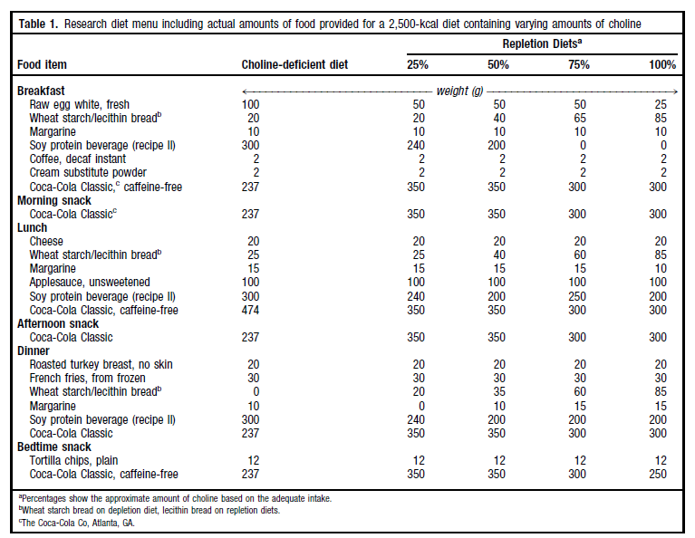
Subjects were exposed to a rigorously controlled diet…

Slide 5
15 Patients
74 DNA samples isolated from fecal samples
Run on ½ of a 454-FLX LR70 plate using a “barcode” strategy
213,375 16S rRNA sequences.
Average read length=264 bp.
( around $0.03 per sequence)
199,186 “usable” sequences
(Exactly match 5’-primer; length >200 bp)
Cluster into 7,514 Operational Taxonomic Units (OTUs)
in each of which all sequences are at least 97% identical
Spencer et al, Association between composition of the human gastrointestinal microbiome and development of fatty liver with choline deficiency,2011

Slide 6
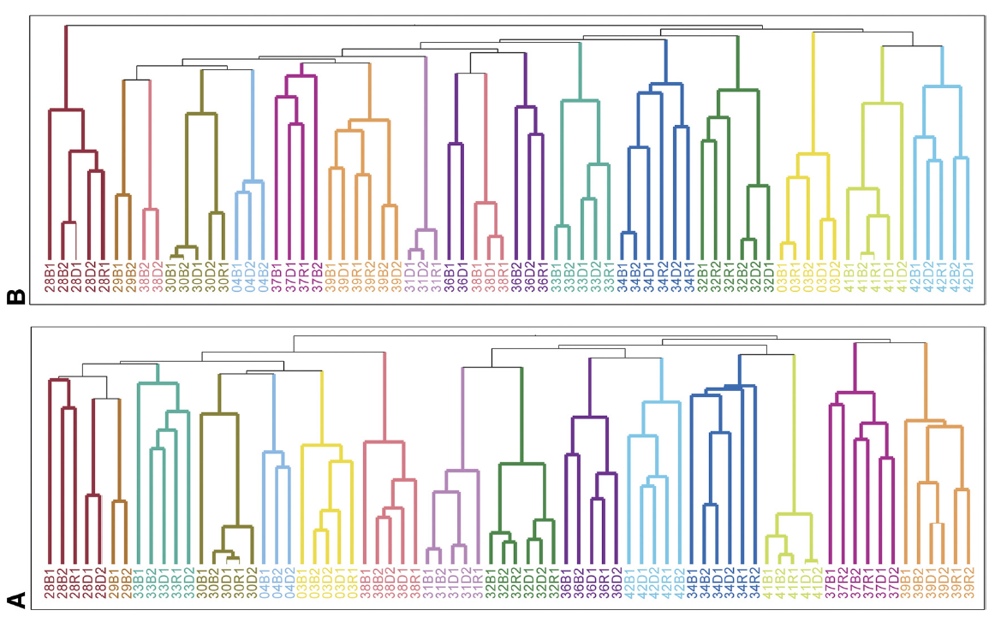
The gut microbiome is individual, stable over time and surprisingly resistant to short-term changes in diet…
Spencer et al, Association between composition of the human gastrointestinal microbiome and development of fatty liver with choline deficiency,2011

Slide 7
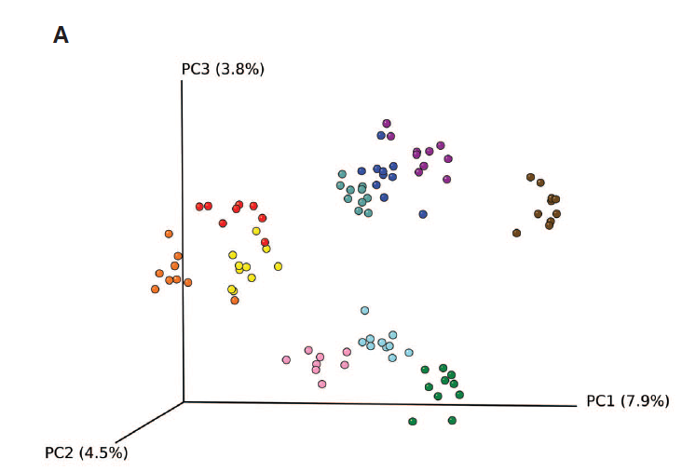
The gut microbiome is individual, stable over time and surprisingly resistant to short-term changes in diet…
Wu et.al - Linking Long-Term Dietary Patterns with Gut Microbial Enterotypes, 2011

Slide 8
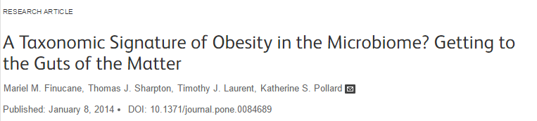
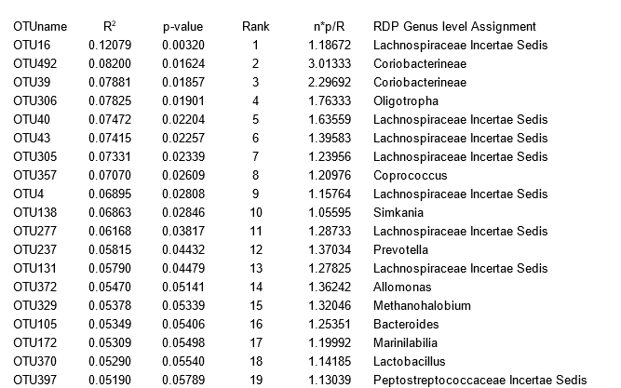
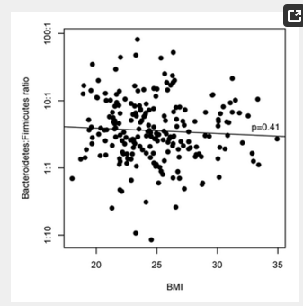
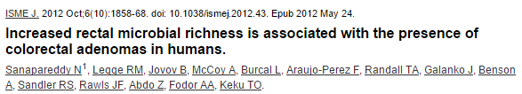
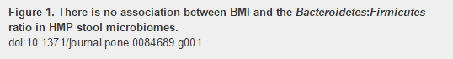
Initial encouraging results in obesity have largely failed to replicate….

Slide 9
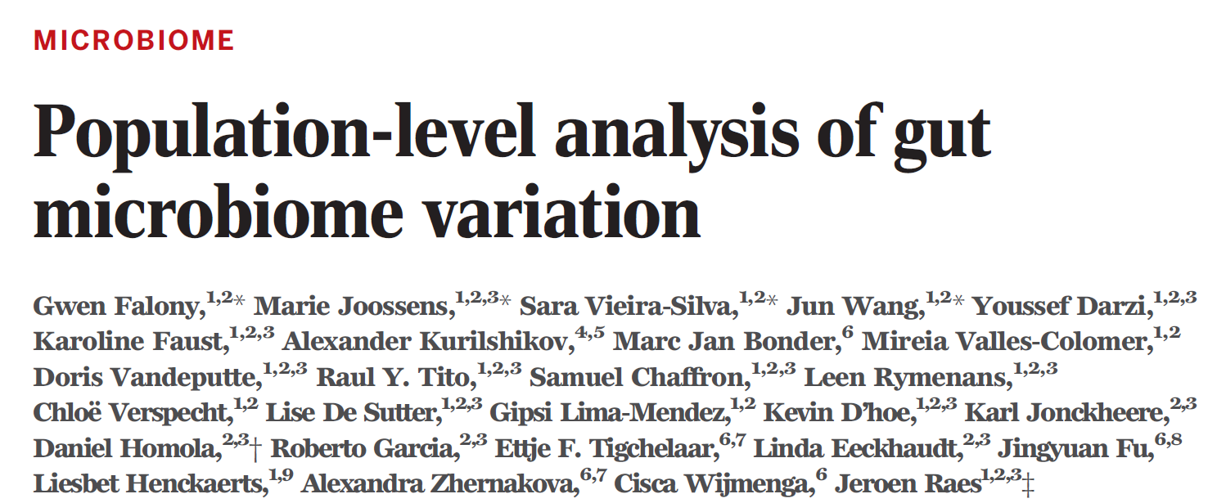
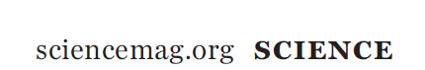
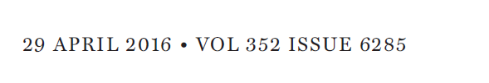
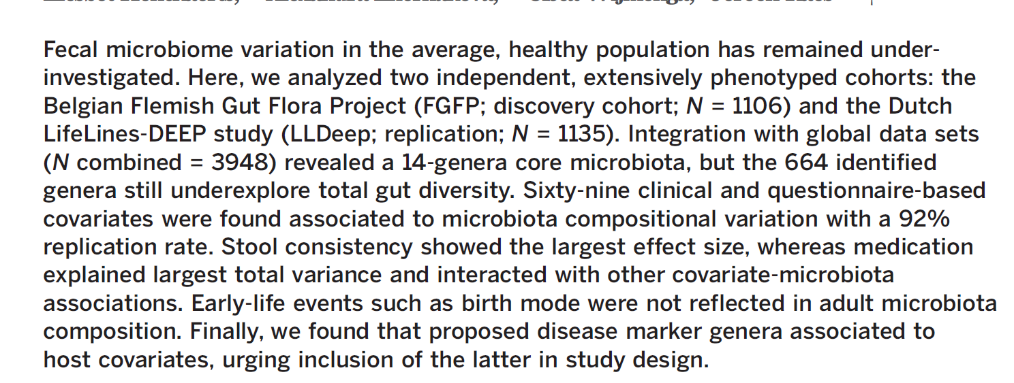
Gut microbial associations with healthy variation lie somewhere
between small and vanishingly small

Slide 10
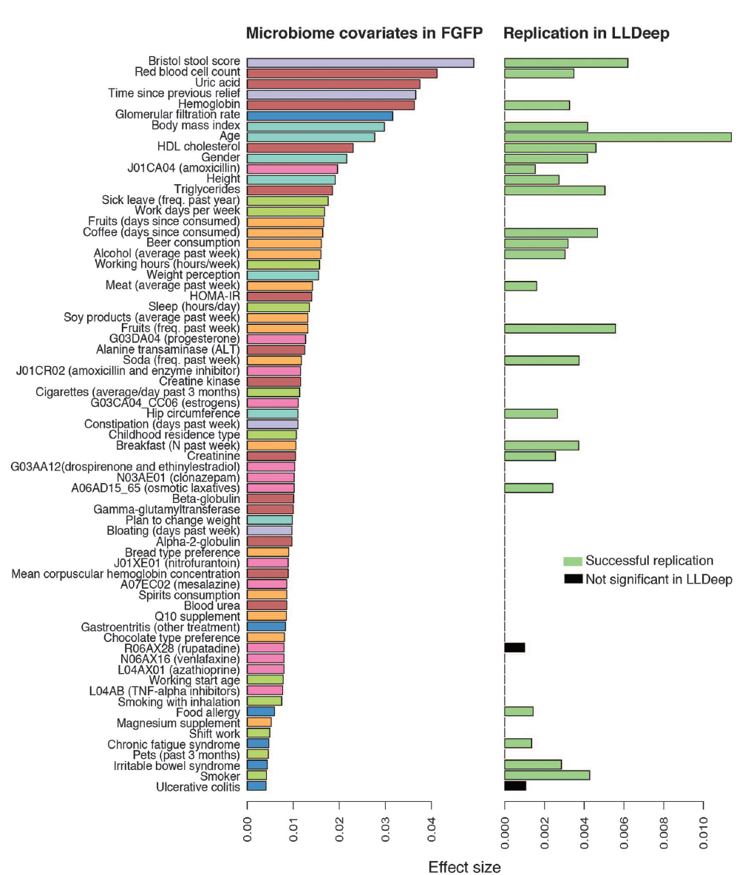
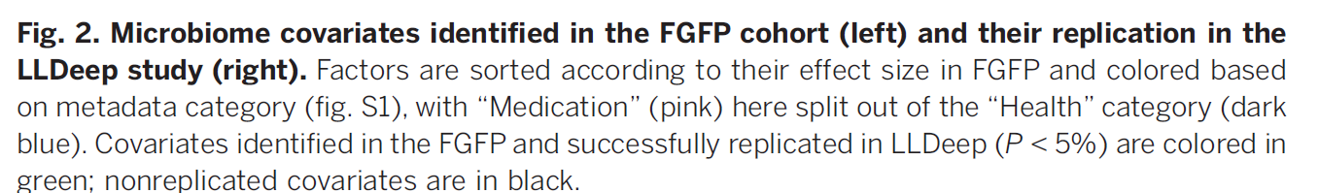
Initial analysis: 503 metadata variables
69 significant at 10% FDR
26 have analog in replication cohort
24 of these are significant
(but effect sizes in replicate cohort drop to << .01)
Power estimates suggests > 1600 subjects
needed to power BMI study…

Slide 11
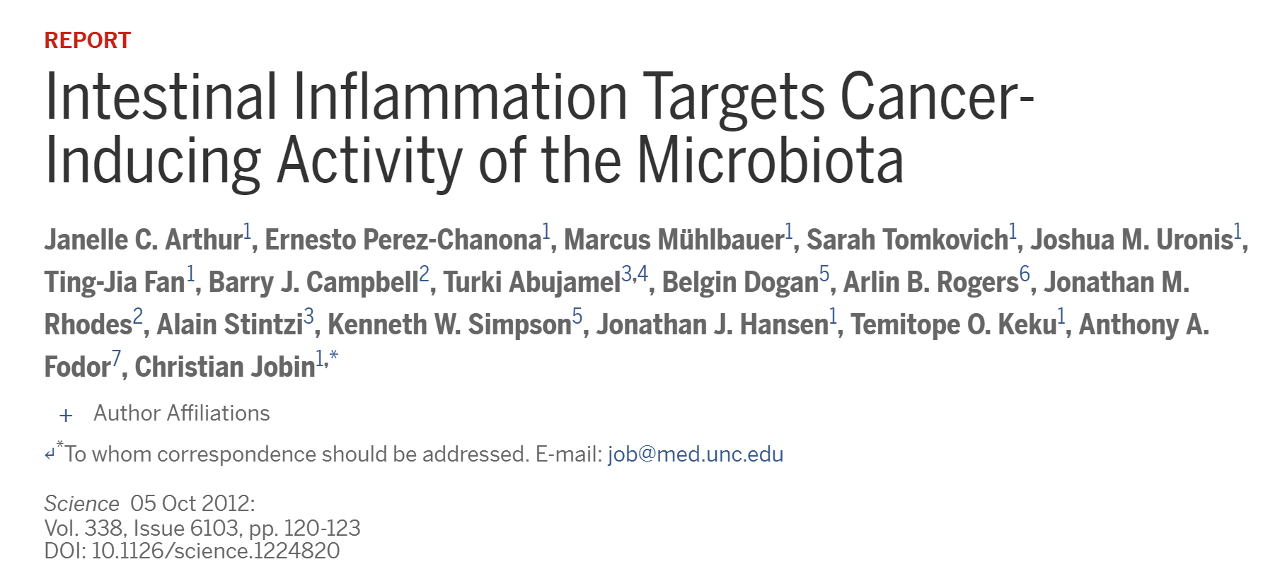
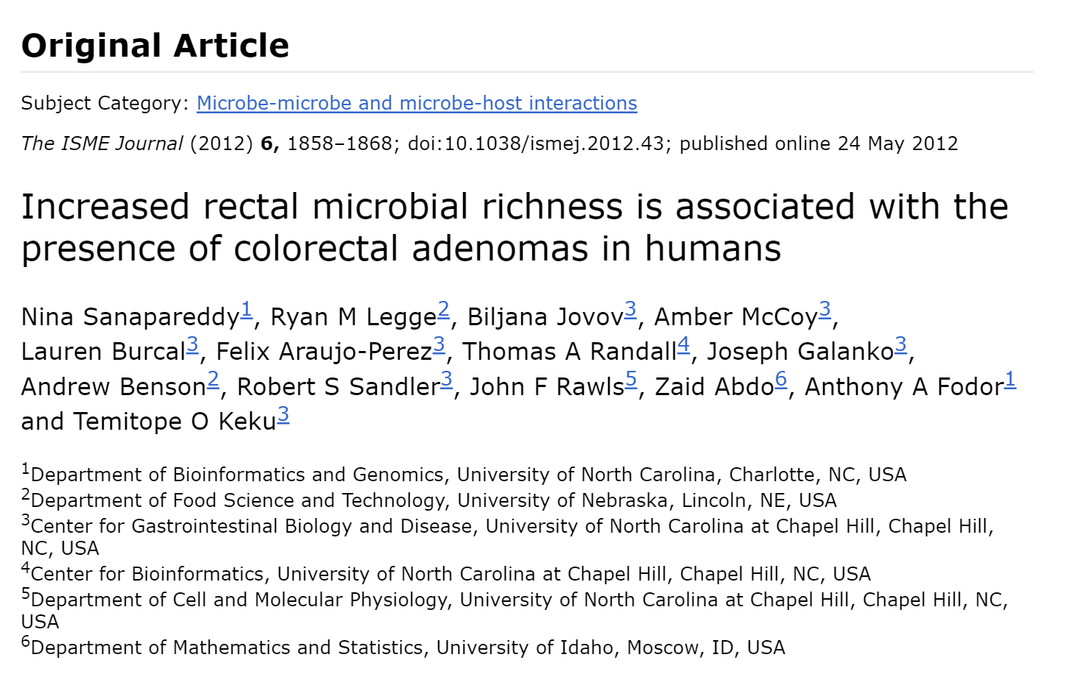
Effect sizes can be more robust in comparing case and control…
Association of E. Coli with CRC –
odds ratio of ~3.2 (although we didn’t report it as such….)
Top hits associated with colorectal adenomas with effect sizes of ~1.0 – 2.0
(although we didn’t report them as such….)

Slide 12
How large are associations with health and disease?
How accurate are our measurements?

Slide 13
Sources of Bias:
Extraction methods - Getting the DNA
PCR – amplifying the 16S gene
Sequencing
All of these can make contributions to irreproducibility
but extraction methods appear to make the largest contribution

Slide 14
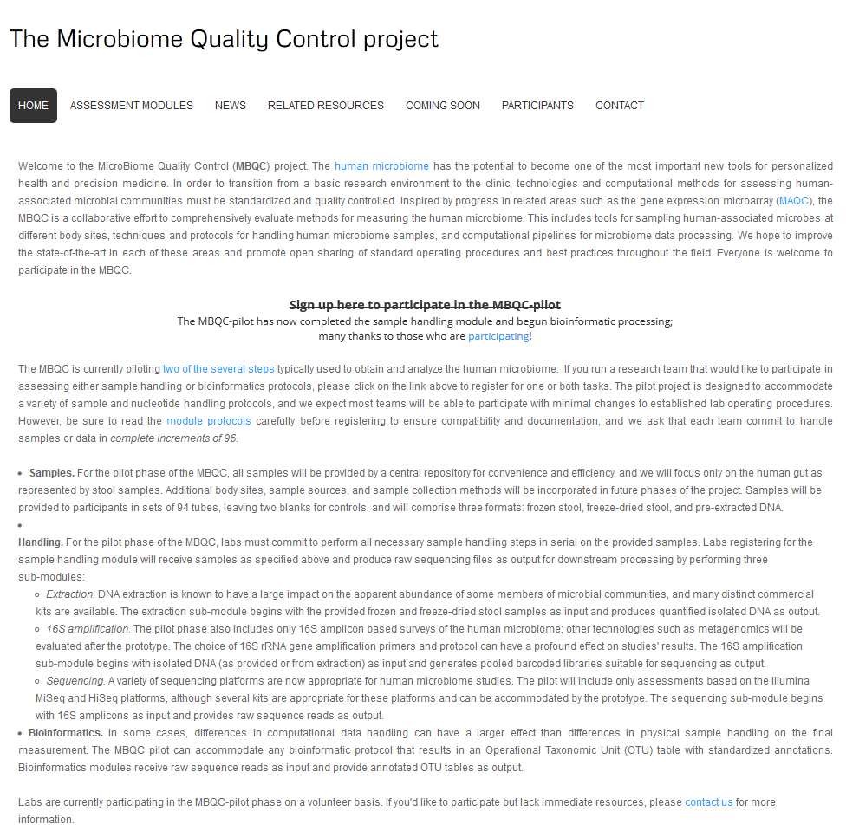
http://www.mbqc.org/

Slide 15
Participating laboratories
Name | Affiliation | Handling | Bioinformatics
Allen-Vercoe | University of Guelph | X
Burk | Albert Einstein College of Medicine | X | X
Bushman | University of Pennsylvania | X
Caporaso | Northern Arizona University |  | X
Chia | Mayo Clinic |  | X
Flores | Division of Cancer Prevention, NCI | X
Gevers | Broad Institute | X
Gloor | University of Western Ontario | X | X
Goodman | Yale | X
Huttenhower | Harvard School of Public Health |  | X
Knight | University of California, San Diego | X | X
Littman | New York University | X
Mills | University of California, Davis | X
Petrosino | Baylor College of Medicine | X | X
Ravel | University of Maryland | X | X
Schloss | University of Michigan | X
Shanks | Environmental Protection Agency | X
Turnbaugh | Univeristy of California, San Francisco | X
Yeager/Yu | Division of Cancer Epidemiology and Genetics, NCI | X | X
 | Total | 16 | 9

Slide 16
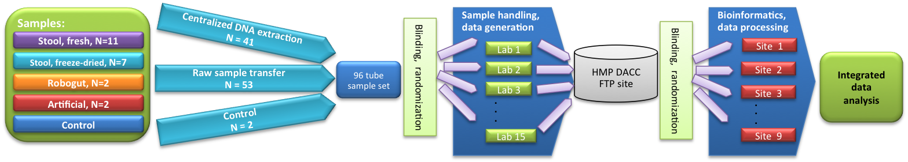
MBQC Study design

Slide 17
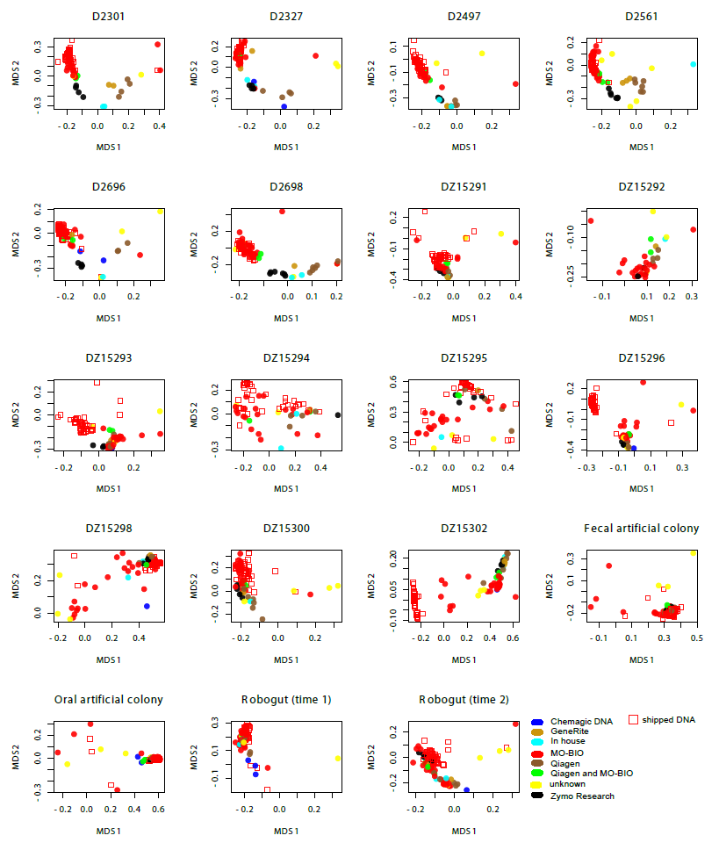
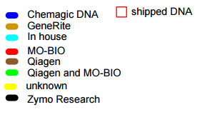
Multi-Dimensional Scaling plots by extraction kit (Bray-Curtis)
Notes:
Graph shows multi-dimensional scaling plots (similar to PCA plots) for all samples from all labs used in MBQC study. The graph is for only one bioinformatics pipeline. The different colors are for extraction kits. Square shape is for DNA extracted at central lab.
Overall, however, our data are consistent with kit manufacturer introducing systematic bias – e.g., Mo-Bio in red are all superimposed.

Slide 18
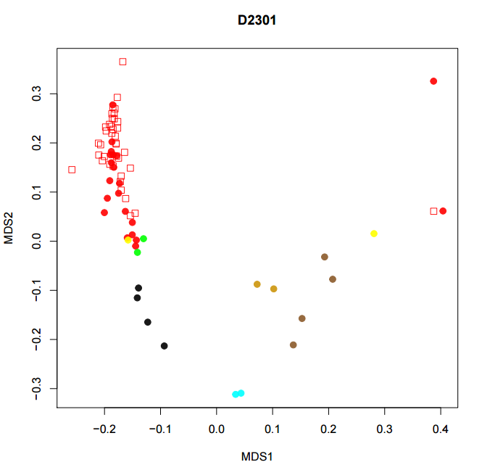
Extraction kit explains a good deal of the
overall variation for many samples…

Slide 19
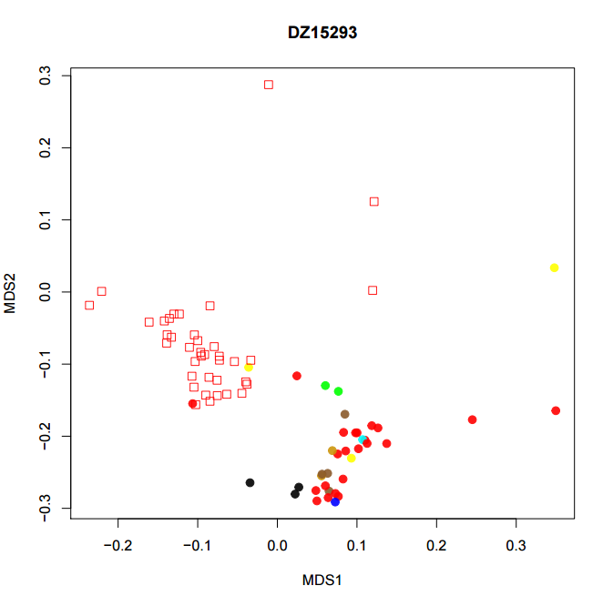
But not for every sample…

Slide 20
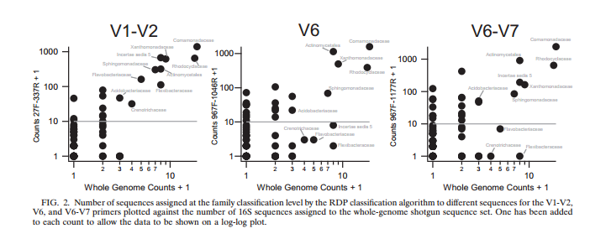
Whole genome and PCR based 16S rRNA tend to agree on prevalent taxa but disagree on rare taxa
Hamp et al. – 2009 - Effects of Experimental Choices and Analysis Noise on Surveys of the “Rare Biosphere” - AEM

Slide 21
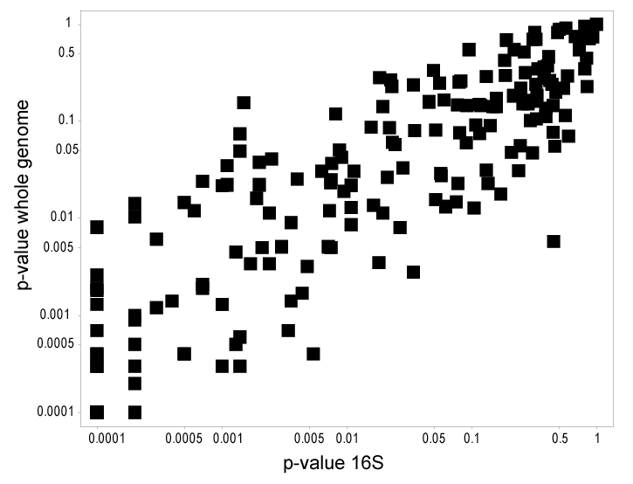
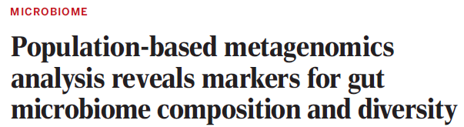
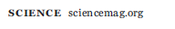
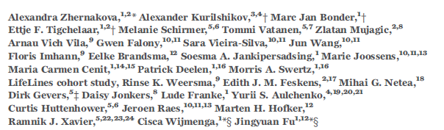
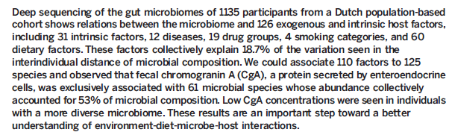
Within the same lab, inference performed on WGS and 16S can be very similar
Supplementary table 7

Slide 22
Conclusions:
Microbial association with healthy variation can be vanishingly small
(but maybe future approaches will have more power!)
Lab to lab variation can be substantial, but standardizing techniques can help achieve reproducibility.
Extraction protocols contribute a large degree of variability
The results of QA/QC experiments will be different for different samples.
It may be difficult to define a single “best practices” pipeline

Slide 23
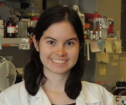











UNC-Chapel Hill
Janelle Arthur
Annie Green Howard
Marcus Muhlbauer
Penny Gordon-Larsen
UNC-Charlotte
Ra’ad Gharaibeh
Jon McCafferty
Kathryn Winglee
UF- Gainesville
Christian Jobin
MBQC consortium
Rashmi Sinha
(steering committee)
Christian Abnet
Rob Knight
Curtis Huttenhower
Owen White
Kathryn Winglee
Annie Green Howard
Penny Gordon-Larsen
Raad Gharaibeh
Jon McCafferty
Marcus Muhlbauer
Janelle Arthur
Christian Jobin

Slide 25
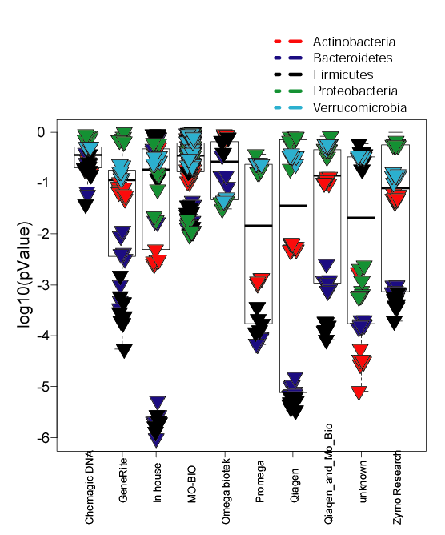
Overall, our data are consistent with kit manufacturer introducing systematic bias
Null hypothesis:
DNA extracted at
University of Guelph with MoBio
has the same distribution as
DNA extracted with different kits
by individual labs..

Slide 26
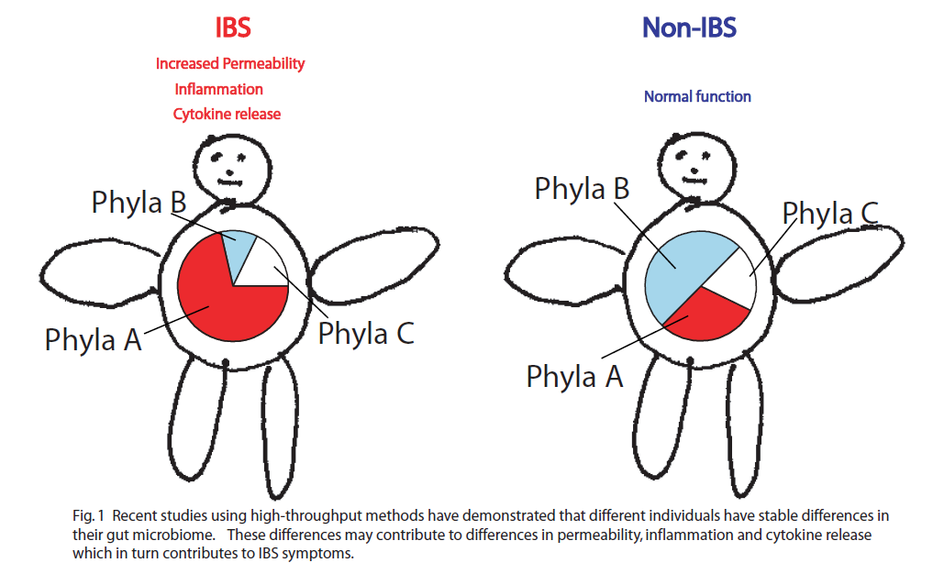
How does the microbial community impact disease? (2011)

Slide 27
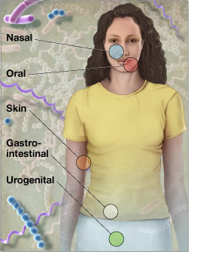
Microbes run the world!
There are 1-10 times more microbial
cells in our body than human cells
There are 100 times more genes
in those microbes than human genes
http://www.genome.gov/images/feature_images/nr_hmp.jpg

Slide 28
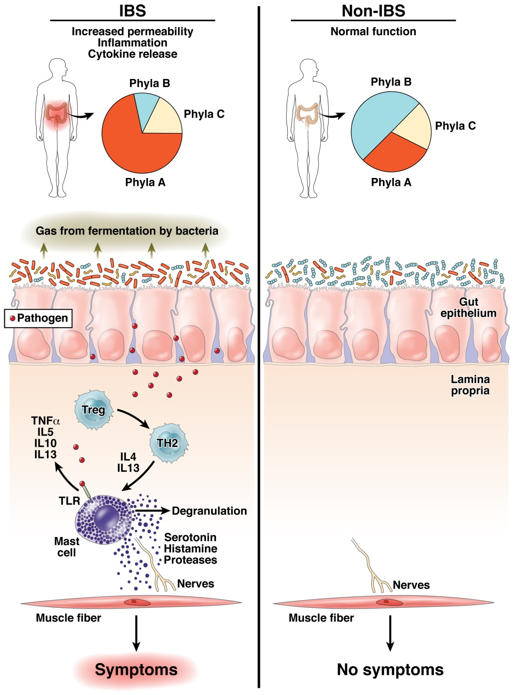
The “dysbiosis hypothesis” is central to our thinking about the role of the
microbiome in human health
Fodor & Talley. Gastroenterology. 2011

Slide 29
dysbiosis hypothesis
There are many, many
alternative, healthy
microbiome configurations;
Healthy variation is not
driven by the microbiome
Your individual microbiome is not so easy to change (at least with diet)
There are fewer dysbiotic states ;
Disease states can be
driven by the microbiome
Opposite of Anna Karenina
Fodor & Talley. Gastroenterology. 2011

